Slide 1
Phishing Attacks

Slide 2
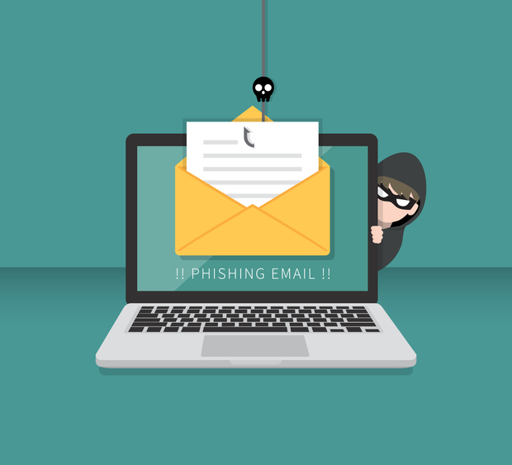
What is Phishing?
When attackers send scam emails(or text messages) that contain links to malicious websites.

Slide 3
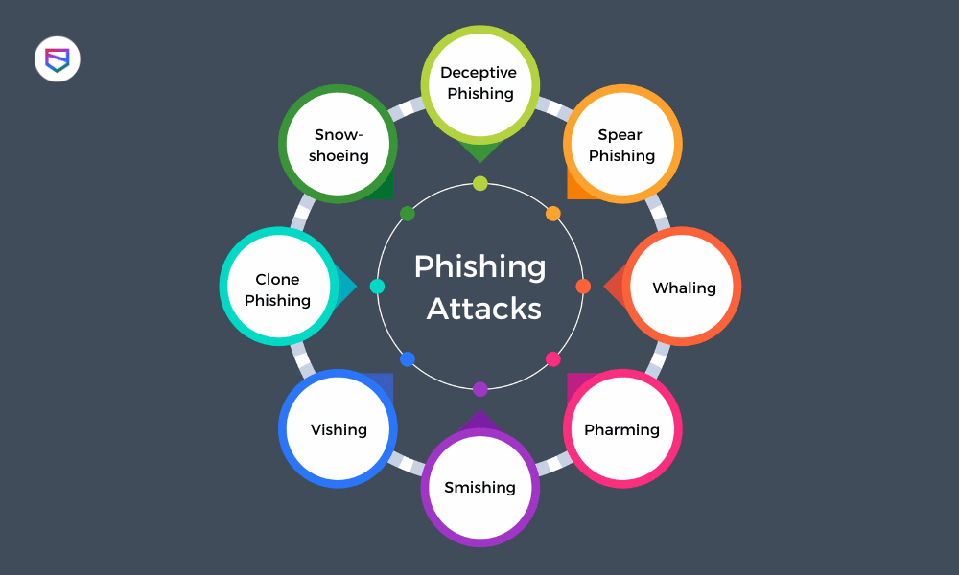
Types Of Phishing Attacks

Slide 4
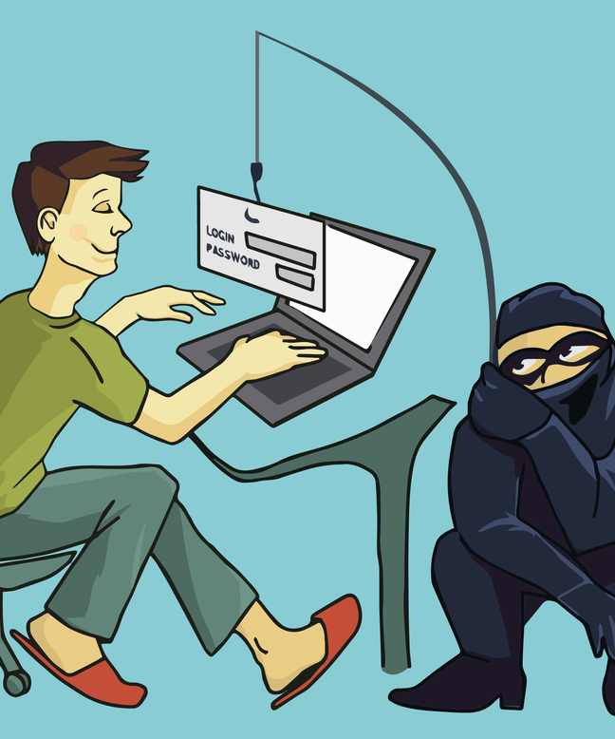
1) Email Phishing
They are the fake emails that appear to be from a trusted source.

Slide 5
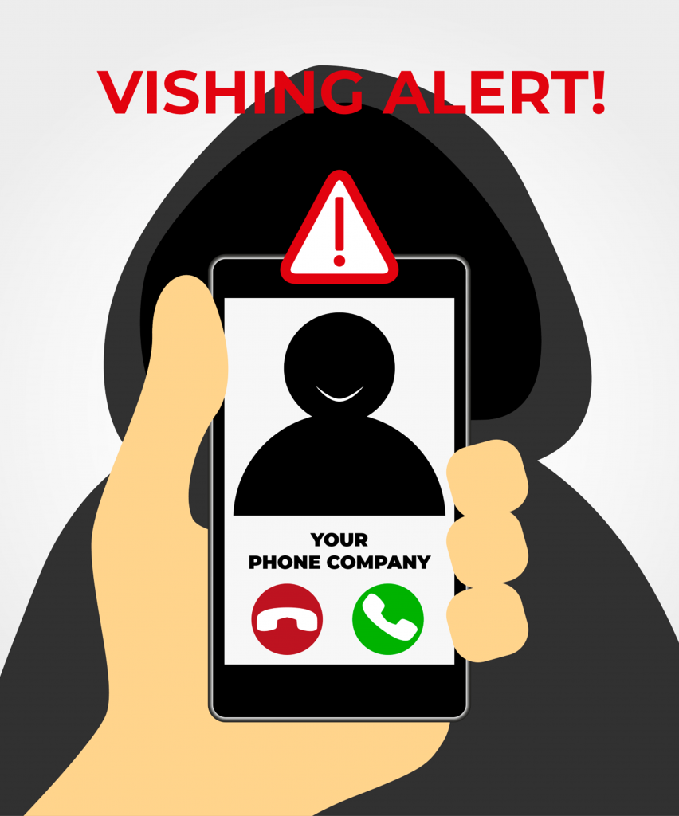
2) Vishing
Fraudulent phone calls or messages designed to trick victims into providing sensitive information.

Slide 6
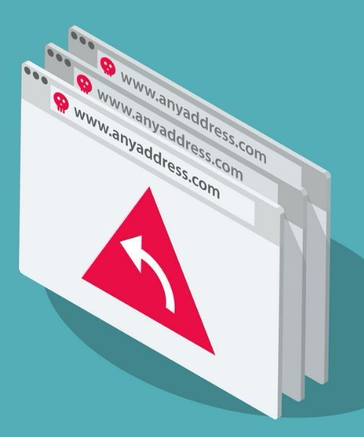
3) Pharming
Sending users to fake websites to trick them into offering their personal data or login credentials for a website.

Slide 7
Recognizing Phishing Emails
Suspicious Sender Email Address.
Generic Greetings (“Dear Customers”).
Urgent language or threats (“Immediate action required!”).
Misspellings and poor grammar.
Unexpected attachments or links.
Hovering over links before clicking (checking for fake URLs).

Slide 8
Phishing Websites & Social Engineering Tactics
Fake login pages (lookalike websites mimicking real ones).
Spoofed company domains (e.g., “g00gle.com” instead of “google.com”).
Manipulative tactics (pretending to be IT support, a manger , or a government official).
Social media phishing (fake friend requests, DMs with malicious links)

Slide 9
How To Avoid Phishing Attacks?
Do Not click on suspicious links or attachments.
Verify sender authenticity (call or email separately to confirm requests).
Enable multi-factor authentication (MFA) for extra security .
Use strong, unique passwords for different accounts.
Keep software and antivirus updated.
Report Phishing attempts to IT/security teams.

Slide 10
What to do if you Suspect a Phishing Attempt ?
Do Not respond or engage with the message.
Report the email to IT/Security department.
Delete the message immediately.
If you accidentally clicked, reset passwords and scan for malware.

Slide 11
Thank You

